Slide 1
Relational Model

Slide 2
Relational Integrity Constraints
Constraints are conditions that must hold on all valid relation instances. There are three main types of constraints:
Key constraints
Entity integrity constraints
Referential integrity constraints

Slide 3
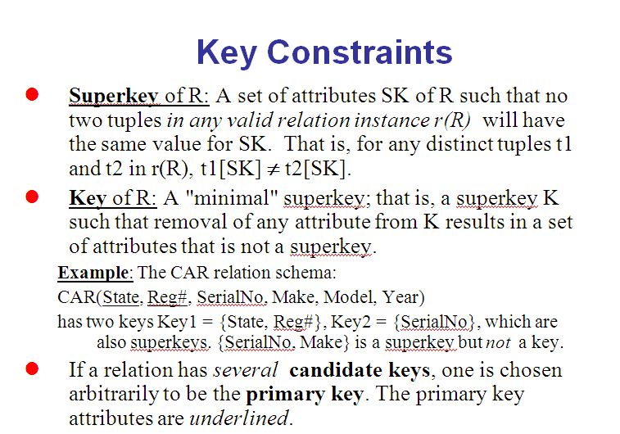

Slide 4
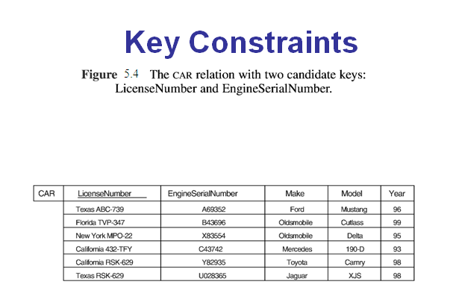

Slide 5
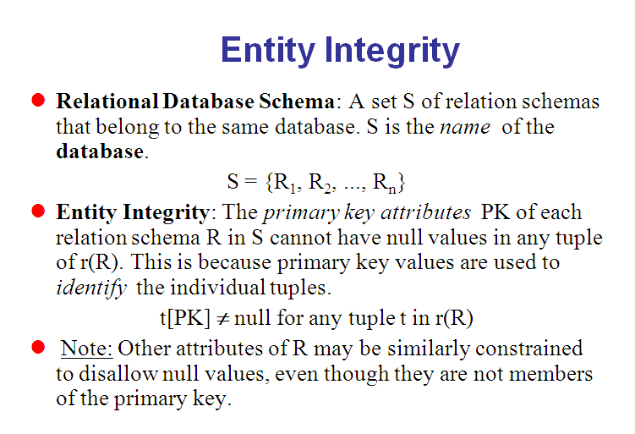

Slide 6
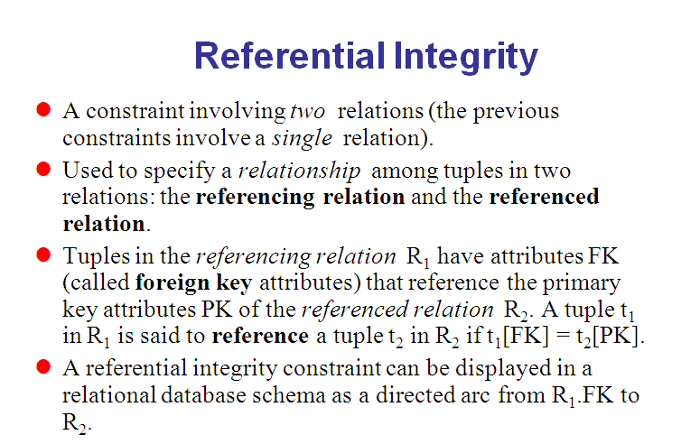

Slide 7
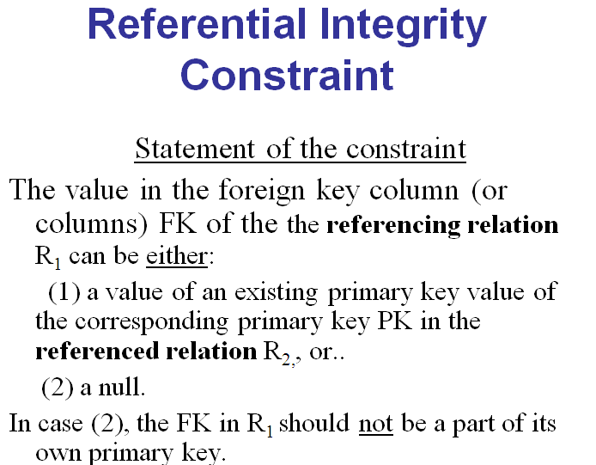

Slide 8
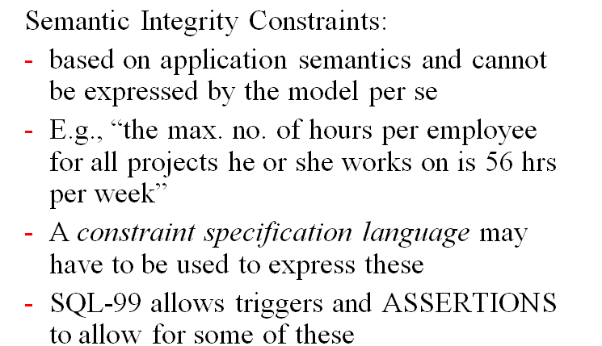
Other Types of Constraints

Slide 9
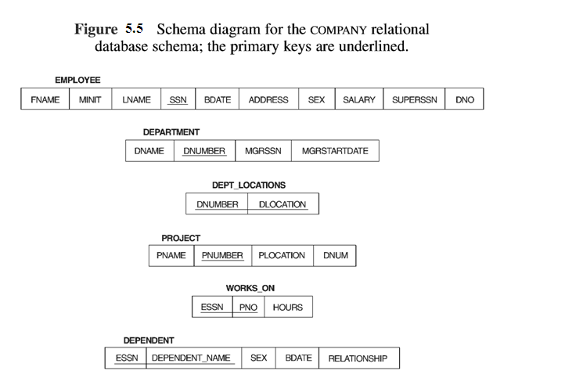

Slide 10
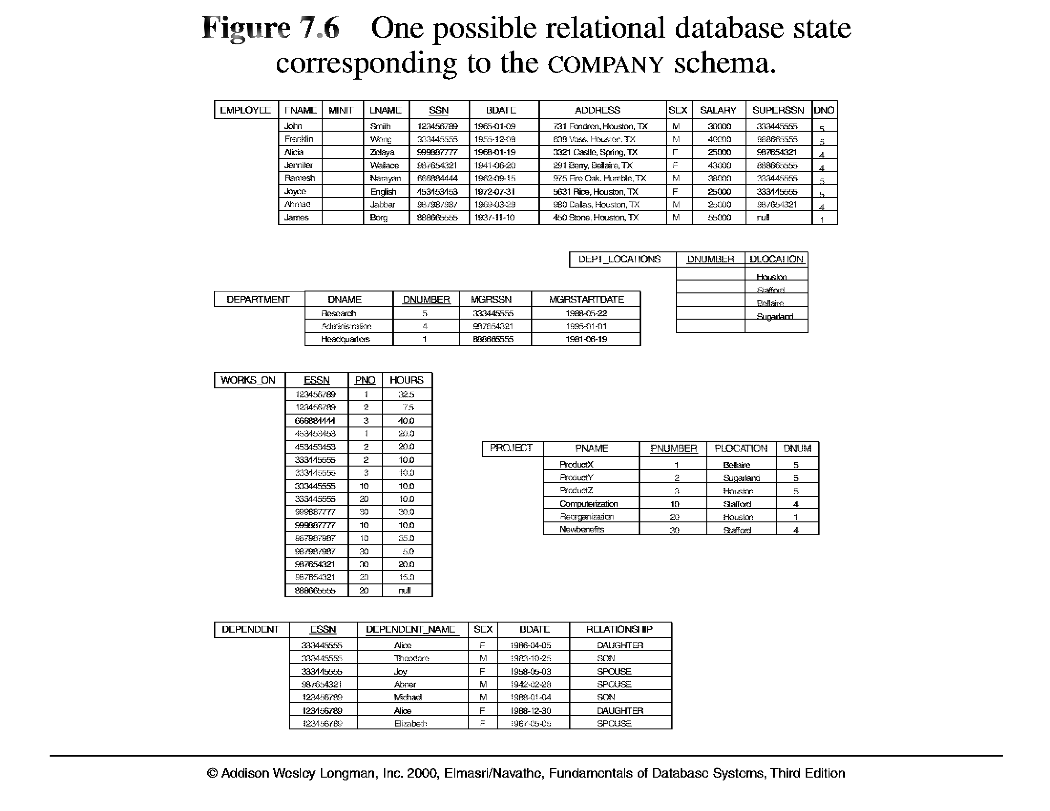

Slide 11
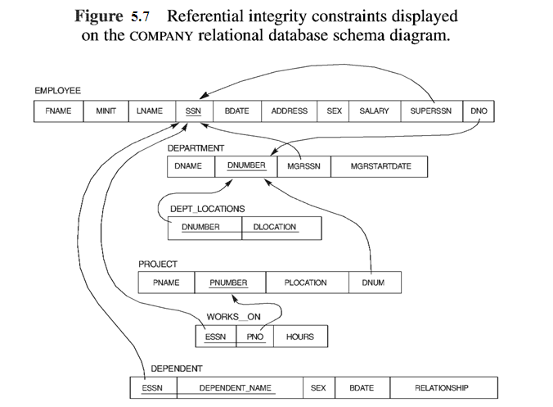

Slide 12
Update Operations on Relations
INSERT a tuple.
DELETE a tuple.
MODIFY a tuple.
Integrity constraints should not be violated by the update operations.
Several update operations may have to be grouped together.

Slide 13
Update Operations on Relations
In case of integrity violation, several actions can be taken:
Cancel the operation that causes the violation (REJECT option)
Perform the operation but inform the user of the violation
Trigger additional updates so the violation is corrected (CASCADE option, SET NULL option)
Execute a user-specified error-correction routine

Slide 14
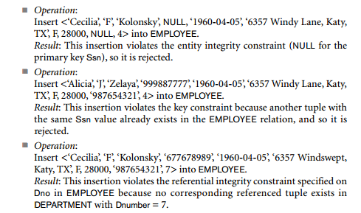
Insert operation-can violate all 4 constraints

Slide 15
options
reject the insertion.
to attempt to correct the reason for rejecting the insertion,

Slide 16
The Update Operation-
Updating an attribute that is neither part of a primary key nor of a foreign key usually causes no problems;

Slide 17
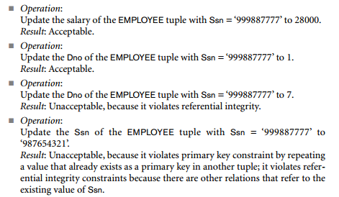

Slide 18
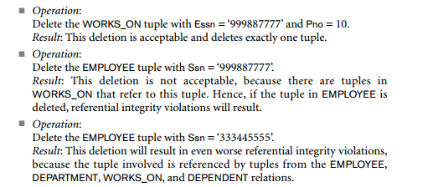
The Delete Operation -can violate only referential integrity

Slide 19
options
restrict,---is to reject the deletion
Cascade--is to attempt to cascade (or propagate) the deletion by deleting tuples that reference the tuple that is being deleted.
A third option, called set null or set default, is to modify the referencing attribute values that cause the violation; each such value is either set to NULL or changed to reference another default valid tuple.
if a referencing attribute that causes a violation is part of the primary key, it cannot be set to NULL; otherwise, it would violate entity integrity.

Slide 20
The Relational Algebra
The basic set of operations for the relational model is the relational algebra.
A sequence of relational algebra operations forms a relational algebra expression
the relational calculus (there is no order of operations) provides a higher-level declarative language for specifying relational queries
procedural query language

Slide 21
Relational Algebra Overview
Relational Algebra consists of several groups of operations
Unary Relational Operations
SELECT (symbol: σ (sigma))
PROJECT (symbol: π (pi))
RENAME (symbol: ρ (rho))
Relational Algebra Operations From Set Theory
UNION ( ∪ ), INTERSECTION ( ∩ ), DIFFERENCE (or MINUS, – )
CARTESIAN PRODUCT ( x )
Binary Relational Operations
JOIN (several variations of JOIN exist)
DIVISION
Additional Relational Operations
OUTER JOINS, OUTER UNION
AGGREGATE FUNCTIONS (These compute summary of information: for example, SUM, COUNT, AVG, MIN, MAX)

Slide 22
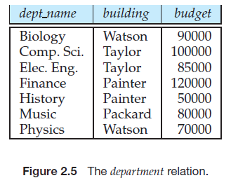
department (dept name, building, budget)

Slide 23
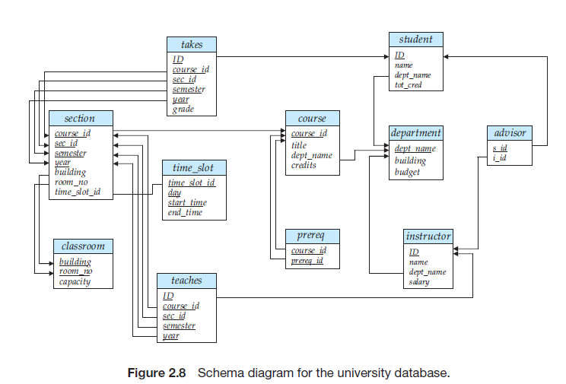

Slide 24
Relational Query Languages
query language is a language in which a user requests information from the database.
Relational Operations:All procedural relational query languages provide a set of operations that can be applied to either a single relation or a pair of relations.

Slide 25
Select Operation
The SELECT operation (denoted by σ (sigma)) is used to select a subset of the tuples from a relation based on a selection condition.
The selection condition acts as a filter
Keeps only those tuples that satisfy the qualifying condition
Tuples satisfying the condition are selected whereas the other tuples are discarded (filtered out)
Examples:
Select the EMPLOYEE tuples whose department number is 4:
σ _{DNO = 4} (EMPLOYEE)
Select the employee tuples whose salary is greater than $30,000:
σ _{SALARY > 30,000} (EMPLOYEE)

Slide 26
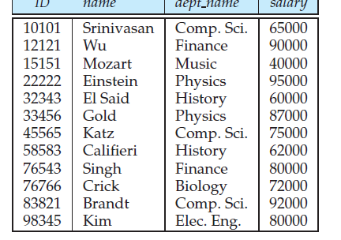


Select:The number of tuples in the result of a SELECT is less than (or equal to) the number of tuples in the input relation R

Slide 27
Unary Relational Operations: PROJECT
PROJECT Operation is denoted by π (pi)
This operation keeps certain columns (attributes) from a relation and discards the other columns.
PROJECT creates a vertical partitioning
The list of specified columns (attributes) is kept in each tuple
The other attributes in each tuple are discarded
Example: To list each employee’s first and last name and salary, the following is used:
π_{LNAME, FNAME,SALARY}(EMPLOYEE)

Slide 28
PROJECT Operation Properties
The number of tuples in the result of projection π_{<list>}(R) is always less or equal to the number of tuples in R
If the list of attributes includes a key of R, then the number of tuples in the result of PROJECT is equal to the number of tuples in R
PROJECT is not commutative
π _{<list1>} (π _{<list2>} (R) ) = π _{<list1>} (R) as long as <list2> contains the attributes in <list1>

Slide 29

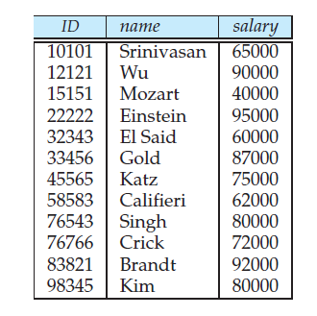
Project

Slide 30
Single expression versus sequence of relational operations (Example)
To retrieve the first name, last name, and salary of all employees who work in department number 5, we must apply a select and a project operation
We can write a single relational algebra expression as follows:
π_{FNAME, LNAME, SALARY}(σ _{DNO=5}(EMPLOYEE))
OR We can explicitly show the sequence of operations, giving a name to each intermediate relation:
DEP5_EMPS ← σ _{DNO=5}(EMPLOYEE)
RESULT ← π _{FNAME, LNAME, SALARY} (DEP5_EMPS)

Slide 31

Find the name of all instructors in the
Physics department.

Slide 32
Unary Relational Operations: RENAME
The RENAME operator is denoted by ρ (rho)
In some cases, we may want to rename the attributes of a relation or the relation name or both
Useful when a query requires multiple operations
Necessary in some cases (see JOIN operation later)

Slide 33
The general RENAME operation ρ can be expressed by any of the following forms:
ρ_{S (B1, B2, …, Bn )}(R) changes both:
the relation name to S, and
the column (attribute) names to B1, B1, …..Bn
ρ_{S}(R) changes:
the relation name only to S
ρ_{(B1, B2, …, Bn )}(R) changes:
the column (attribute) names only to B1, B1, …..Bn

Slide 34
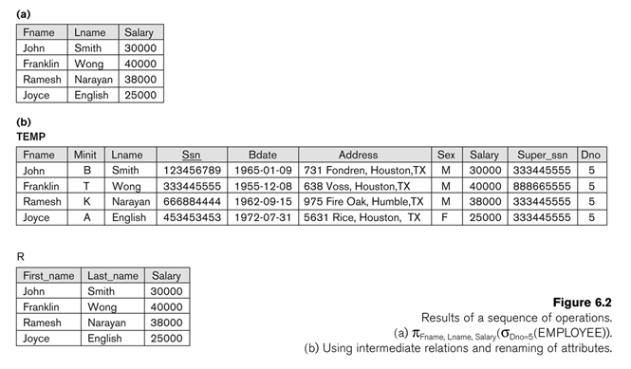

Slide 35
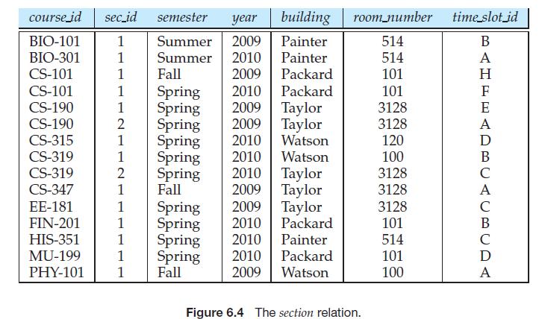

The Union Operation
Set of all courses taught in the Fall 2009 semester

Slide 36
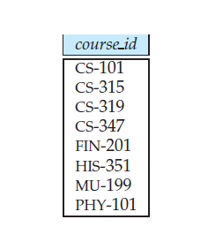

Courses offered in either Fall 2009, Spring 2010 or both semesters.

Slide 37
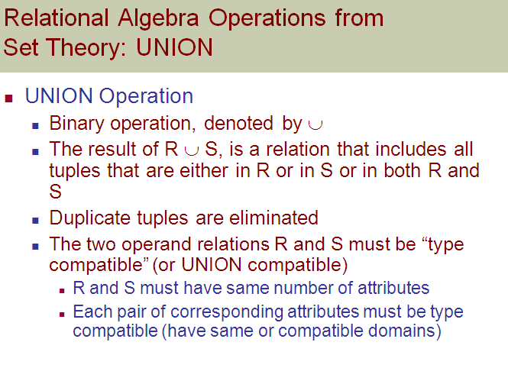

Slide 38
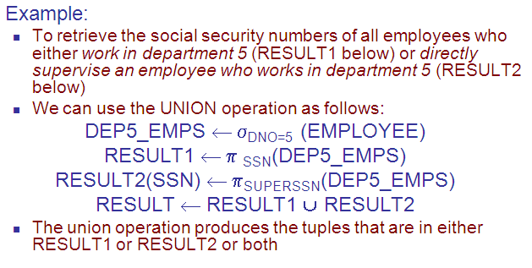

Slide 39


Set-Difference Operation

Slide 40
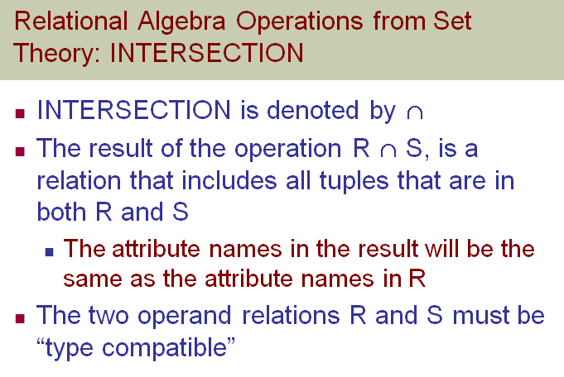

Slide 41
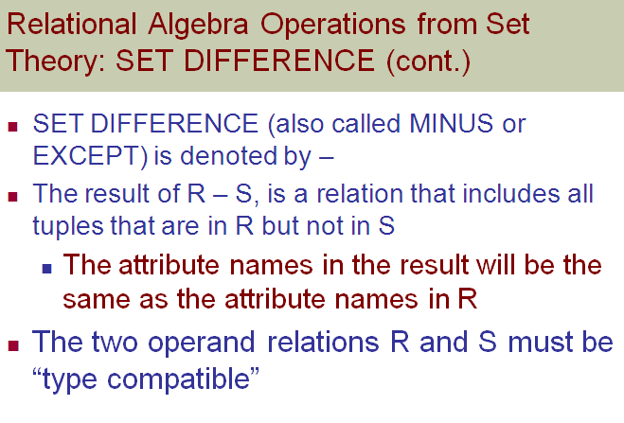

Slide 42
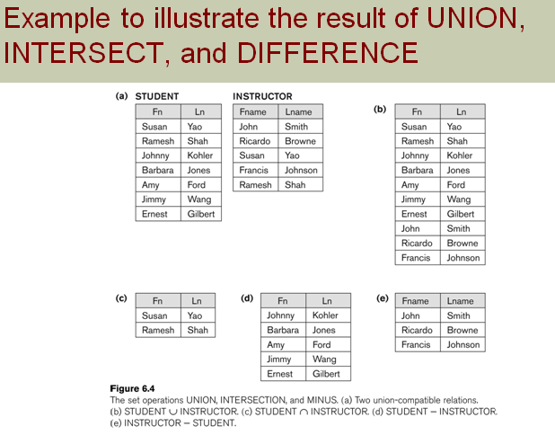

Slide 43
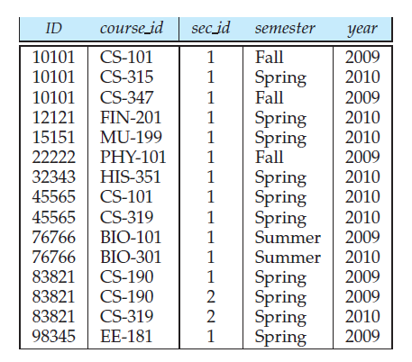
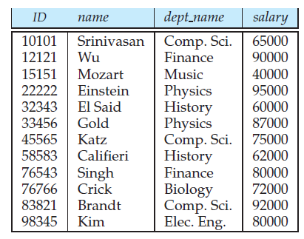
The Cartesian-Product Operation

Slide 44
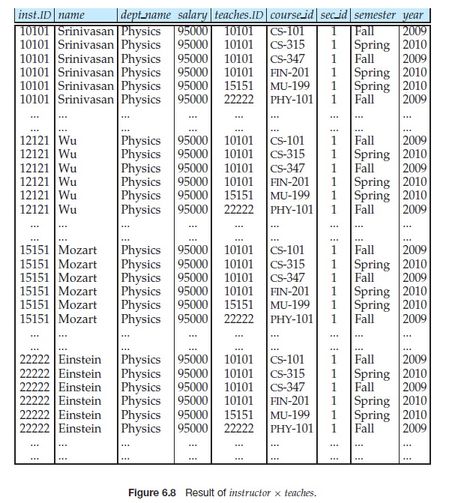

Slide 45
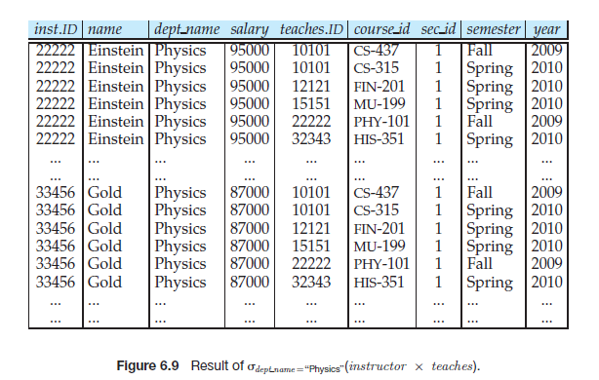

Slide 46
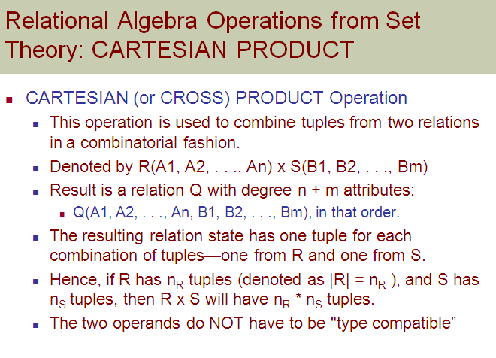

Slide 47


find the names of all instructors in the Physics department together with the course id of all courses they taught.

Slide 48

The Rename Operation

Slide 49

Additional Relational-Algebra Operations
The Set-Intersection Operation
r ∩ s = r − (r − s)

Slide 50
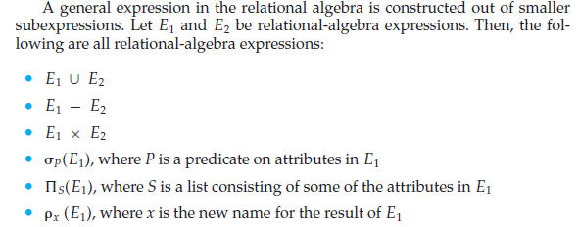
Relational Algebra

Slide 51
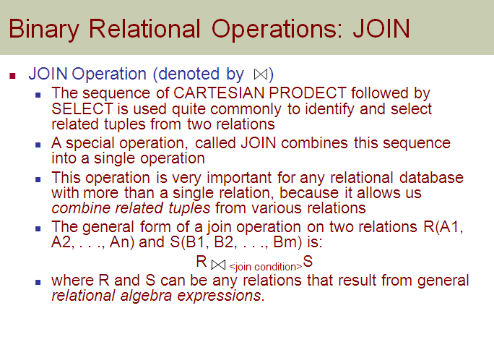

Slide 52
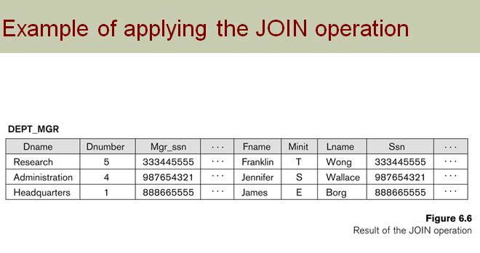

Slide 53
Some properties of JOIN
Consider the following JOIN operation:
R(A1, A2, . . ., An) S(B1, B2, . . ., Bm)
R.Ai=S.Bj
Result is a relation Q with degree n + m attributes:
Q(A1, A2, . . ., An, B1, B2, . . ., Bm), in that order.
The resulting relation state has one tuple for each combination of tuples—r from R and s from S, but only if they satisfy the join condition r[Ai]=s[Bj]
Hence, if R has n_{R} tuples, and S has n_{S} tuples, then the join result will generally have less than n_{R} * n_{S} tuples.
Only related tuples (based on the join condition) will appear in the result

Slide 54
Some properties of JOIN
The general case of JOIN operation is called a Theta-join: R S
theta
The join condition is called theta
Theta can be any general boolean expression on the attributes of R and S; for example:
R.Ai<S.Bj AND (R.Ak=S.Bl OR R.Ap<S.Bq)
Most join conditions involve one or more equality conditions “AND”ed together; for example:
R.Ai=S.Bj AND R.Ak=S.Bl AND R.Ap=S.Bq

Slide 55
Binary Relational Operations: EQUIJOIN
EQUIJOIN Operation
The most common use of join involves join conditions with equality comparisons only
Such a join, where the only comparison operator used is =, is called an EQUIJOIN.
In the result of an EQUIJOIN we always have one or more pairs of attributes (whose names need not be identical) that have identical values in every tuple.
The JOIN seen in the previous example was an EQUIJOIN.

Slide 56
Binary Relational Operations: NATURAL JOIN Operation
NATURAL JOIN Operation
Another variation of JOIN called NATURAL JOIN — denoted by * — was created to get rid of the second (superfluous) attribute in an EQUIJOIN condition.
because one of each pair of attributes with identical values is superfluous
The standard definition of natural join requires that the two join attributes, or each pair of corresponding join attributes, have the same name in both relations
If this is not the case, a renaming operation is applied first.

Slide 57
Binary Relational Operations NATURAL JOIN (contd.)
Example: To apply a natural join on the DNUMBER attributes of DEPARTMENT and DEPT_LOCATIONS, it is sufficient to write:
DEPT_LOCS ← DEPARTMENT * DEPT_LOCATIONS
Only attribute with the same name is DNUMBER
An implicit join condition is created based on this attribute:
DEPARTMENT.DNUMBER=DEPT_LOCATIONS.DNUMBER
Another example: Q ← R(A,B,C,D) * S(C,D,E)
The implicit join condition includes each pair of attributes with the same name, “AND”ed together:
R.C=S.C AND R.D.S.D
Result keeps only one attribute of each such pair:
Q(A,B,C,D,E)

Slide 58
Binary Relational Operations: DIVISION
DIVISION Operation
The division operation is applied to two relations
R(Z) ÷ S(X), where X subset Z. Let Y = Z - X (and hence Z = X ∪ Y); that is, let Y be the set of attributes of R that are not attributes of S.
The result of DIVISION is a relation T(Y) that includes a tuple t if tuples t_{R} appear in R with t_{R} [Y] = t, and with
t_{R} [X] = t_{s} for every tuple t_{s} in S.
For a tuple t to appear in the result T of the DIVISION, the values in t must appear in R in combination with every tuple in S.

Slide 59
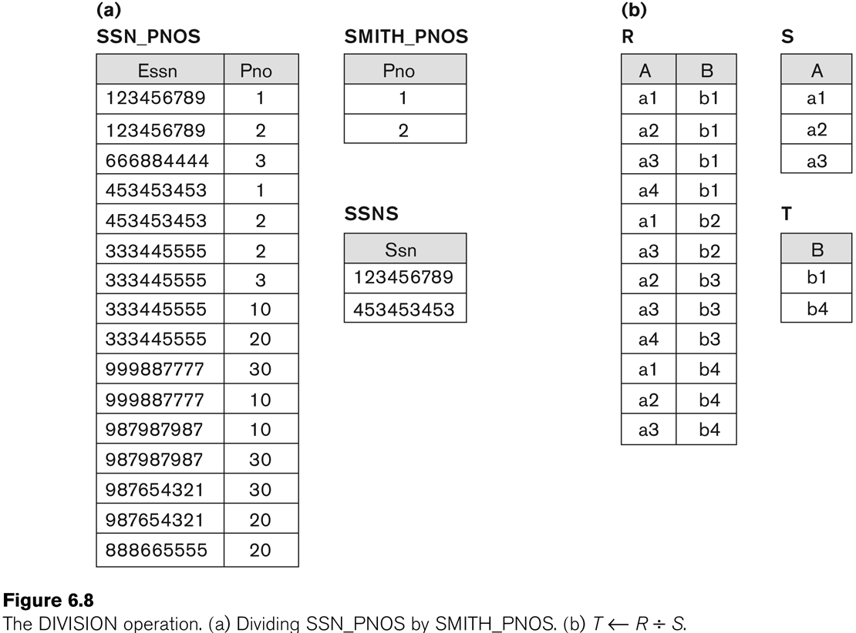
Example of DIVISION

Slide 60
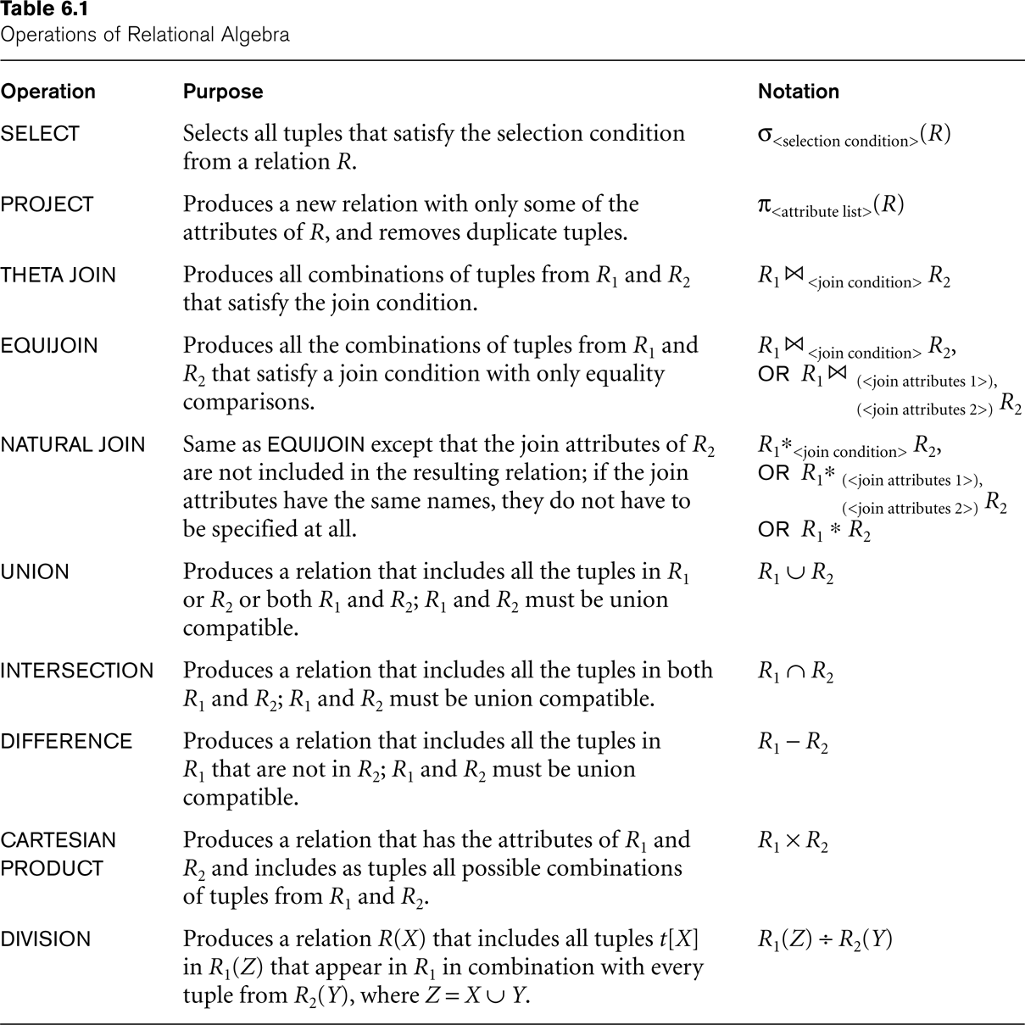
Recap of Relational Algebra Operations

Slide 61


Extended Relational-Algebra Operations-Generalized Projection
extends the projection operation by allowing operations such as arithmetic and string functions to be used in the projection list.

Slide 62
Query Trees
A query tree is a tree data structure that corresponds to a relational algebra expression. It represents the input relations of the query as leaf nodes of the tree, and represents the relational algebra operations as internal nodes

Slide 63

For every project located in ‘Stafford’, list the project number, the controlling department number, and the department manager’s last name, address, and birth date

Slide 64
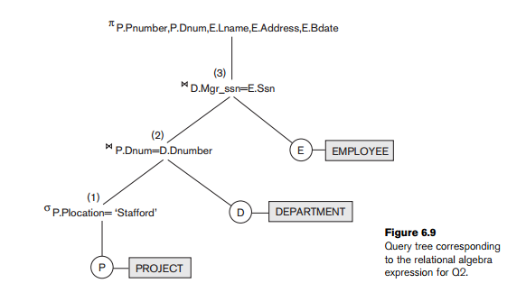

Slide 65

Aggregate Functions and Grouping
Request that cannot be expressed in the basic relational algebra
Specify mathematical aggregate functions on collections of values from the database.
SUM, AVERAGE, MAXIMUM, and MINIMUM & COUNT

Slide 66
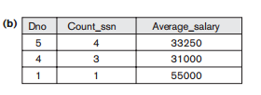

Slide 67


Slide 68
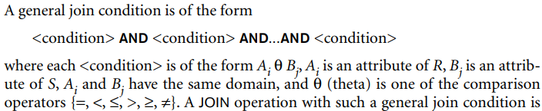
Theta Join
Condition is of the form Ai θ Bj

Slide 69
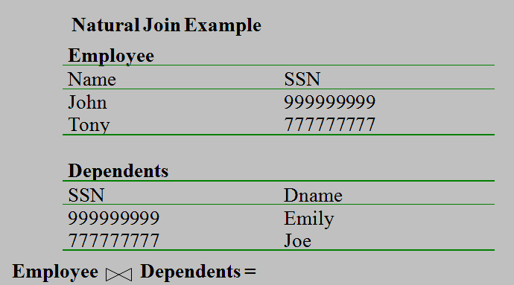
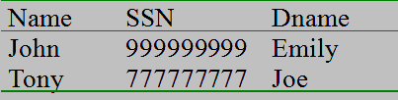

Slide 70
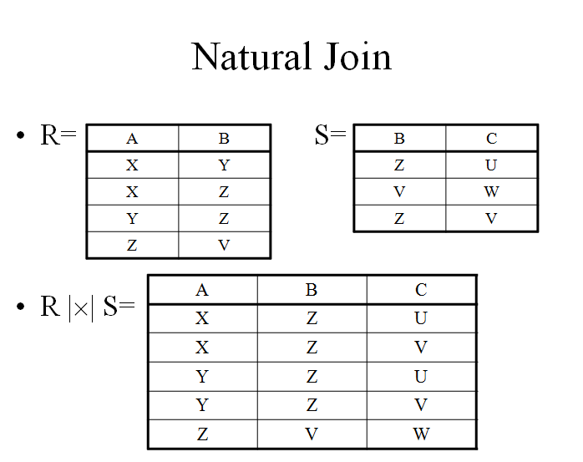

Slide 71
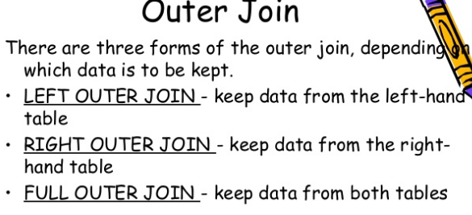
Outer join

Slide 72


Slide 73
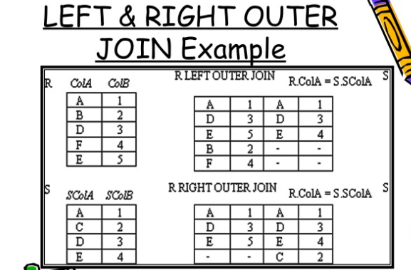

Slide 74
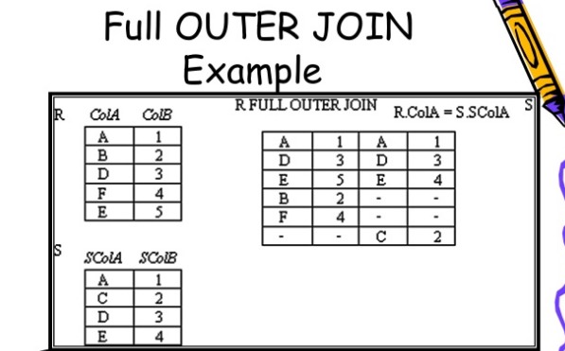

Slide 75
Theta Join
Condition is of the form Ai θ Bj

Slide 78
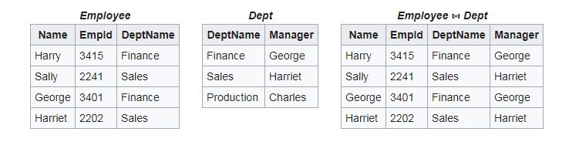

Slide 79
Outer join

Slide 83
Recursive Closure Operations
applied to a recursive relationship between tuples of the same type, such as the relationship between an employee and a supervisor
to retrieve all supervisees of an employee e at all levels—

Slide 84
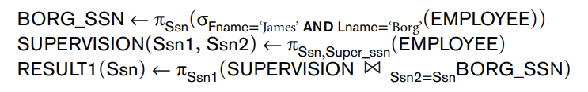
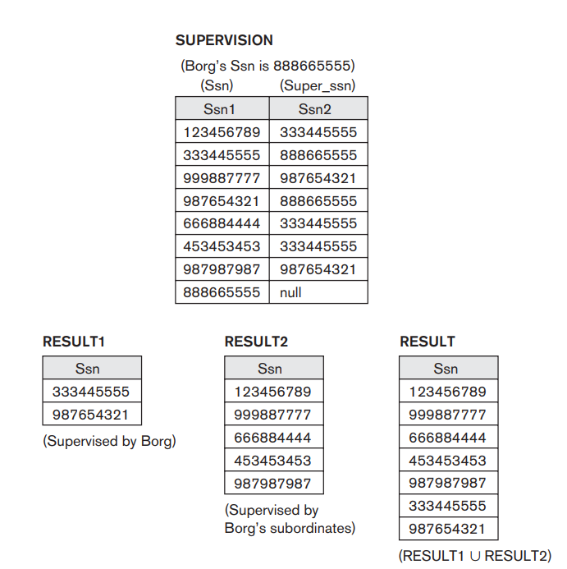

Slide 85
The OUTER UNION Operation
STUDENT(Name, Ssn, Department, Advisor) INSTRUCTOR(Name, Ssn, Department, Rank).
STUDENT_OR_INSTRUCTOR(Name, Ssn, Department, Advisor, Rank)

Slide 86
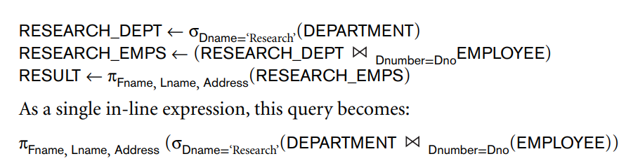
Query 1. Retrieve the name and address of all employees who work for the ‘Research’ department

